Slide 1
Introduction to Parallel and Distributed Programming
Péter Molnár
Institute for Insight
J. Mack Robinson College of Business
Georgia State University

Slide 2

Introduction to Parallel Computing
Traditionally, software has been written for serial computation:
To be run on a single computer having a single Central Processing Unit (CPU);
A problem is broken into a discrete series of instructions.
Instructions are executed one after another.
Only one instruction may execute at any moment in time.

Slide 3

Using multiple processors in parallel
In the simplest sense, parallel computing is the simultaneous use of multiple compute resources to solve a computational problem.
To be run using multiple CPUs
A problem is broken into discrete parts that can be solved concurrently
Each part is further broken down to a series of instructions
Instructions from each part execute simultaneously on different CPUs

Slide 4
Resources
Challenge
The compute resources can include:
A single computer with multiple processors;
A single computer with (multiple) processor(s) and some specialized computer resources (GPU, FPGA …)
An arbitrary number of computers connected by a network;
A combination of both.
The computational problem usually demonstrates characteristics such as the ability to be:
Broken apart into discrete pieces of work that can be solved simultaneously;
Execute multiple program instructions at any moment in time;
Solved in less time with multiple compute resources than with a single compute resource.

Slide 5
Limitations of Serial Computing
Limits to serial computing - both physical and practical reasons pose significant constraints to simply building ever faster serial computers.
Transmission speeds - the speed of a serial computer is directly dependent upon how fast data can move through hardware. Absolute limits are the speed of light (30 cm/nanosecond) and the transmission limit of copper wire (9 cm/nanosecond). Increasing speeds necessitate increasing proximity of processing elements.
Limits to miniaturization - processor technology is allowing an increasing number of transistors to be placed on a chip. However, even with molecular or atomic-level components, a limit will be reached on how small components can be.
Economic limitations - it is increasingly expensive to make a single processor faster. Using a larger number of moderately fast commodity processors to achieve the same (or better) performance is less expensive.

Slide 6
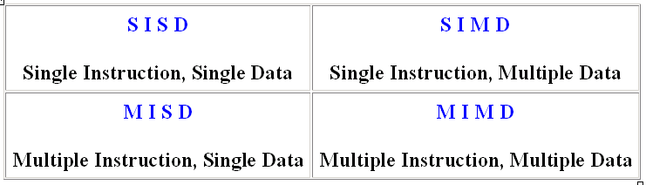
Flynn's Classical Taxonomy
There are different ways to classify parallel computers. One of the more widely used classifications, in use since 1966, is called Flynn's Taxonomy.
The matrix below defines the 4 possible classifications according to Flynn

Slide 7
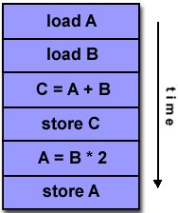
Single Instruction, Single Data (SISD)
A serial (non-parallel) computer
Single instruction: only one instruction stream is being acted on by the CPU during any one clock cycle
Single data: only one data stream is being used as input during any one clock cycle
Deterministic execution
This is the oldest and until recently, the most prevalent form of computer
Examples: most PCs, single CPU workstations and mainframes

Slide 8
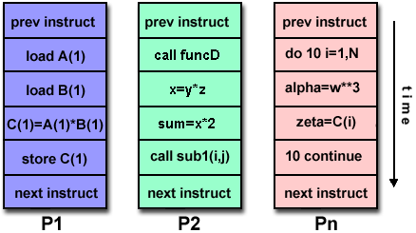
Multiple Instruction, Multiple Data (MIMD)
Currently, the most common type of parallel computer. Most modern computers fall into this category.
Multiple Instruction: every processor may be executing a different instruction stream
Multiple Data: every processor may be working with a different data stream
Execution can be synchronous or asynchronous, deterministic or non-deterministic
Examples: most current supercomputers, networked parallel computer "grids" and multi-processor SMP computers - including some types of PCs.

Slide 9
Task
A logically discrete section of computational work. A task is typically a program or program-like set of instructions that is executed by a processor.
Parallel Task
A task that can be executed by multiple processors safely (yields correct results)
Serial Execution
Execution of a program sequentially, one statement at a time. In the simplest sense, this is what happens on a one processor machine. However, virtually all parallel tasks will have sections of a parallel program that must be executed serially.
Parallel Execution
Execution of a program by more than one task, with each task being able to execute the same or different statement at the same moment in time.
Shared Memory
From a strictly hardware point of view, describes a computer architecture where all processors have direct (usually bus based) access to common physical memory. In a programming sense, it describes a model where parallel tasks all have the same "picture" of memory and can directly address and access the same logical memory locations regardless of where the physical memory actually exists.
Distributed Memory
In hardware, refers to network based memory access for physical memory that is not common. As a programming model, tasks can only logically "see" local machine memory and must use communications to access memory on other machines where other tasks are executing.

Slide 10
Communications
Parallel tasks typically need to exchange data. There are several ways this can be accomplished, such as through a shared memory bus or over a network, however the actual event of data exchange is commonly referred to as communications regardless of the method employed.
Synchronization
The coordination of parallel tasks in real time, very often associated with communications. Often implemented by establishing a synchronization point within an application where a task may not proceed further until another task(s) reaches the same or logically equivalent point.
Synchronization usually involves waiting by at least one task, and can therefore cause a parallel application's wall clock execution time to increase.
Granularity
In parallel computing, granularity is a qualitative measure of the ratio of computation to communication.
Coarse: relatively large amounts of computational work are done between communication events
Fine: relatively small amounts of computational work are done between communication events
Observed Speedup
Observed speedup of a code which has been parallelized, defined as:
wall-clock time of serial execution
wall-clock time of parallel execution
One of the simplest and most widely used indicators for a parallel program's performance.

Slide 11
Parallel Overhead
The amount of time required to coordinate parallel tasks, as opposed to doing useful work. Parallel overhead can include factors such as:
Task start-up time
Synchronizations
Data communications
Software overhead imposed by parallel compilers, libraries, tools, operating system, etc.
Task termination time
Massively Parallel
Refers to the hardware that comprises a given parallel system - having many processors. The meaning of many keeps increasing, but currently BG/L pushes this number to 6 digits.
Scalability
Refers to a parallel system's (hardware and/or software) ability to demonstrate a proportionate increase in parallel speedup with the addition of more processors. Factors that contribute to scalability include:
Hardware - particularly memory-cpu bandwidths and network communications
Application algorithm
Parallel overhead related
Characteristics of your specific application and coding

Slide 12
Parallel Computer Memory Architectures

Slide 13
Memory architectures
Shared Memory
Distributed Memory
Hybrid Distributed-Shared Memory

Slide 14
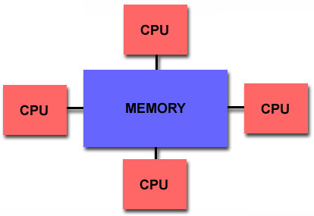
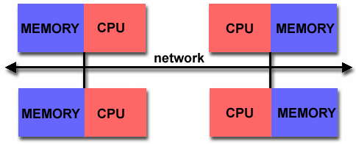
Shared Memory
All processors to access all memory as global address space.
Multiple processors can operate independently but share the same memory resources.
Changes in a memory location effected by one processor are visible to all other processors.
Distributed Memory
Processors have their own local memory. Memory addresses in one processor do not map to another processor, so there is no concept of global address space across all processors.
Changes it makes to its local memory have no effect on the memory of other processors
When a processor needs access to data in another processor, it is usually the task of the programmer to explicitly define how and when data is communicated.
Synchronization between tasks is likewise the programmer's responsibility.

Slide 15
Designing Parallel Programs
Undoubtedly, the first step in developing parallel software is to first understand the problem that you wish to solve in parallel. If you are starting with a serial program, this necessitates understanding the existing code also.
Before spending time in an attempt to develop a parallel solution for a problem, determine whether or not the problem is one that can actually be parallelized.

Slide 16
Example of Parallelizable Problem
Calculate the potential energy for each of several thousand independent conformations of a molecule. When done, find the minimum energy conformation.
This problem is able to be solved in parallel. Each of the molecular conformations is independently determinable. The calculation of the minimum energy conformation is also a parallelizable problem.

Slide 17
Example of a Non-parallelizable Problem
Calculation of the Fibonacci series (1,1,2,3,5,8,13,21,...) by use of the formula:
F(k + 2) = F(k + 1) + F(k)
This is a non-parallelizable problem because the calculation of the Fibonacci sequence as shown would entail dependent calculations rather than independent ones. The calculation of the k + 2 value uses those of both k + 1 and k. These three terms cannot be calculated independently and therefore, not in parallel.

Slide 18
Identify the program's hotspots
Know where most of the real work is being done. The majority of scientific and technical programs usually accomplish most of their work in a few places.
Profilers and performance analysis tools can help here
Focus on parallelizing the hotspots and ignore those sections of the program that account for little CPU usage.

Slide 19
Identify bottlenecks in the program
Are there areas that are disproportionately slow, or cause parallelizable work to halt or be deferred? For example, I/O is usually something that slows a program down.
May be possible to restructure the program or use a different algorithm to reduce or eliminate unnecessary slow areas

Slide 20
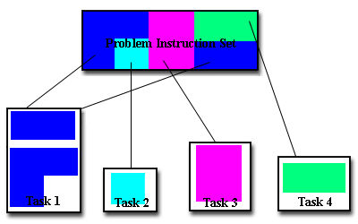
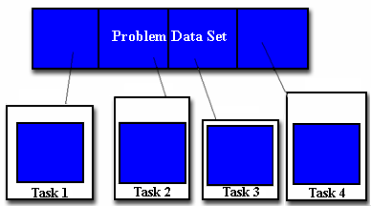
Domain Decomposition
Functional Decomposition
Functional decomposition lends itself well to problems that can be split into different tasks. For example
Ecosystem Modeling
Signal Processing
Climate Modeling
In this type of partitioning, the data associated with a problem is decomposed. Each parallel task then works on a portion of of the data.

Slide 21
Who Needs Communications?
The need for communications between tasks depends upon your problem
You DON'T need communications
Some types of problems can be decomposed and executed in parallel with virtually no need for tasks to share data. For example, imagine an image processing operation where every pixel in a black and white image needs to have its color reversed. The image data can easily be distributed to multiple tasks that then act independently of each other to do their portion of the work.
These types of problems are often called embarrassingly parallel because they are so straight-forward. Very little inter-task communication is required.
You DO need communications
Most parallel applications are not quite so simple, and do require tasks to share data with each other. For example, a 3-D heat diffusion problem requires a task to know the temperatures calculated by the tasks that have neighboring data. Changes to neighboring data has a direct effect on that task's data.

Slide 22
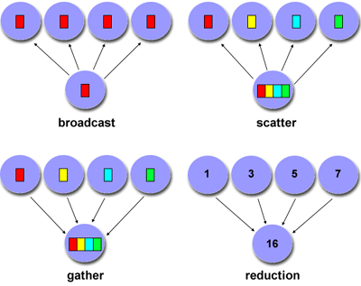
Factors to Consider
Cost of communications
Latency vs. Bandwidth
Visibility of communications (explicit vs. transparent)
Synchronous vs. asynchronous communications (blocking)
Scope of communications (point-to-point, collective)
Efficiency of communications (message passing mechanisms)

Slide 23
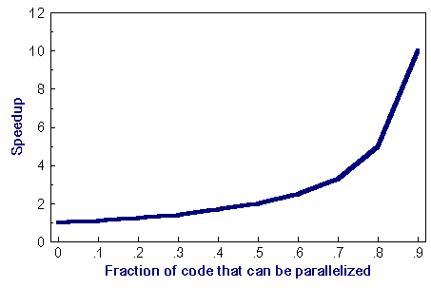
Amdahl's Law
Amdahl's Law states that potential program speedup is defined by the fraction of code (P) that can be parallelized:
1
speedup = --------
1 - P
If none of the code can be parallelized, P = 0 and the speedup = 1 (no speedup). If all of the code is parallelized, P = 1 and the speedup is infinite (in theory).
If 50% of the code can be parallelized, maximum speedup = 2, meaning the code will run twice as fast.
speedup
--------------------------------
N P = .50 P = .90 P = .99
----- ------- ------- -------
10 1.82 5.26 9.17
100 1.98 9.17 50.25
1000 1.99 9.91 90.99
10000 1.99 9.91 99.02

Slide 24
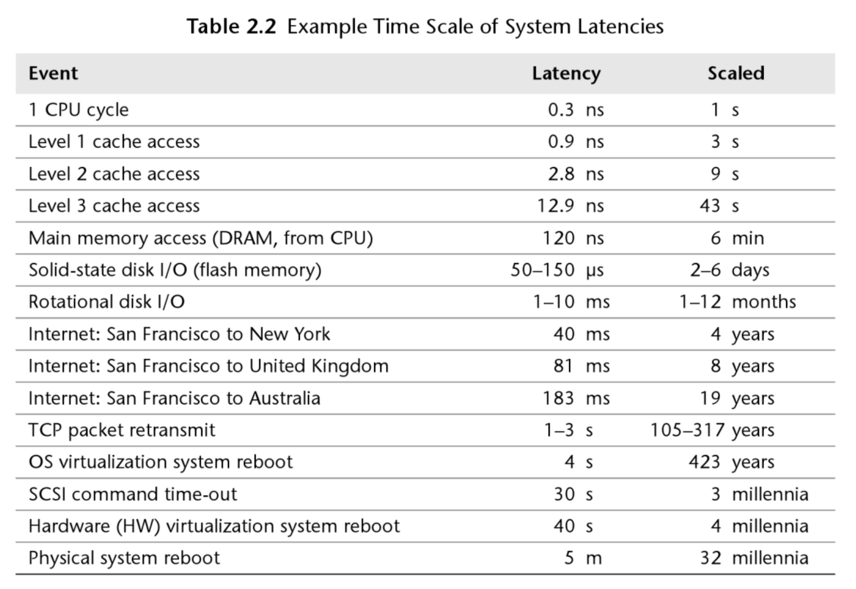


Slide 26
The Hadoop Eco-system
The base Apache Hadoop framework is composed of the following modules:
Hadoop Common – contains libraries and utilities needed by other Hadoop modules.
Hadoop Distributed File System (HDFS) – a distributed file-system that stores data on commodity machines, providing very high aggregate bandwidth across the cluster.
Hadoop YARN – a resource-management platform responsible for managing computing resources in clusters and using them for scheduling of users' applications.
Hadoop MapReduce – a programming model for large scale data processing.

Slide 27
Functionality
Data Management: YARN, HDFS
Data Access: Hive, Pig, MapReduce, Spark, Storm, HBase, Tez, Kafka, Hcatalog, Slider, Solar, Mahout, Accumulo
Data Governance and Integration: Falcon, Flume, Sqoop
Security: Knox, Ranger
Operations: Ambari, Oozie, Zookeeper
Description of these components

Slide 28
HDFS + MapReduce
map(key1,value) -> list<key2,value2>
reduce(key2, list<value2>) -> list<value3>

Slide 31
Usage: $HADOOP_PREFIX/bin/hadoop jar hadoop-streaming.jar [options]Options:
-input
<path> DFS input file(s) for the Map step.
-output
<path> DFS output directory for the Reduce step.
-mapper
<cmd|JavaClassName> Optional. Command to be run as mapper.
-combiner
<cmd|JavaClassName> Optional. Command to be run as combiner.
-reducer
<cmd|JavaClassName> Optional. Command to be run as reducer.

Slide 32
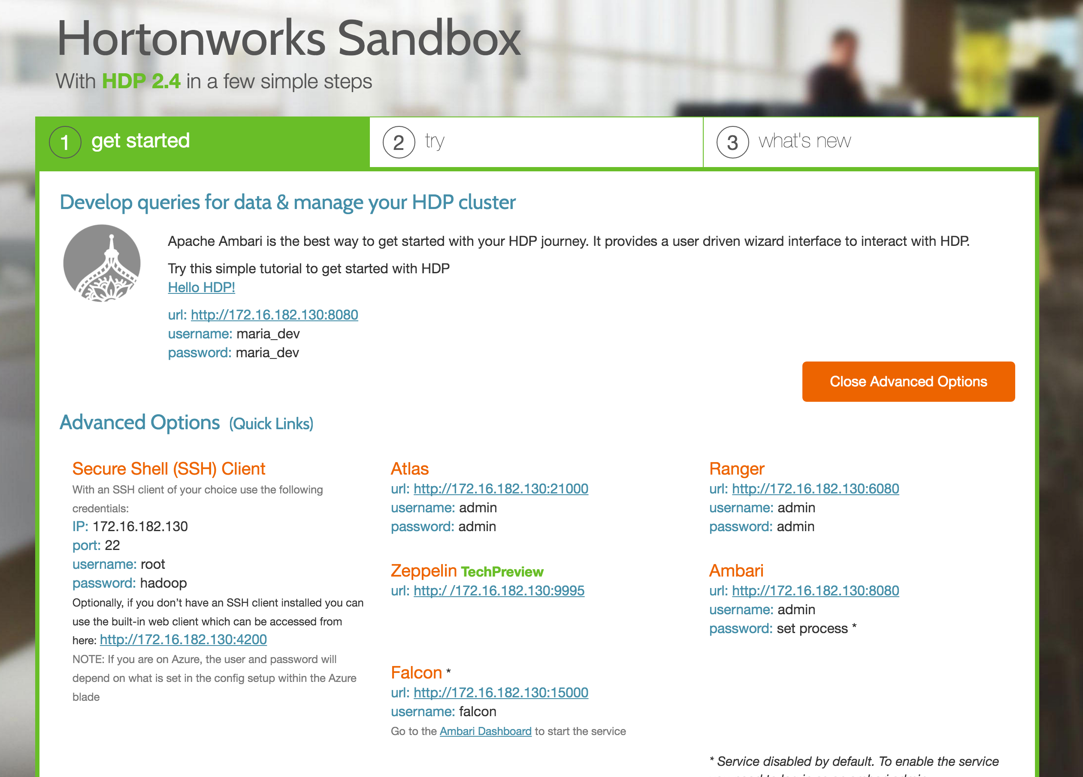

Slide 33
Map-Reduce Streaming API
$ yarn jar /usr/hdp/current/hadoop-mapreduce-client/hadoop-streaming.jar \
-input /demo/data/Website/Website-Logs/* \
-output /home/pmolnar/streamout \
-mapper /bin/cat \
-reducer /bin/cat \
-numReduceTasks 2
$ yarn jar /usr/hdp/current/hadoop-mapreduce-client/hadoop-streaming.jar \
-info
$ export HSTREAMING="$HADOOP_PREFIX/bin/hadoop jar hadoop-streaming.jar"

